Slide 1
The Telco Churn Problem
A Springboard Capstone 2 Project - Eric Olson
The intended audience for this slide deck are high level managers or executives at Telco. For a more technical analysis of this project please see the Capstone2_FinalReport document.

Slide 2
The Problem: Can ML models predict which of Telco’s customers will churn?

Slide 3
Why Does This Matter to Telco?
Churn cost Telco:
$139,130/Month
A 30.5% loss per month
Notes:
The $139,130 was obtained by the summation of the feature that listed what churn customers were charged every month.
The 30.5% loss per month was obtained by dividing the $139,130 per month from the churn customers by the total per month charges of all customers which was $456,115. This was then multiplied by 100 to give a percent.

Slide 4
Why Does This Matter to Telco?
$54,956/month
The amount of revenue Telco could keep if half of the correctly identified churn customers ended up staying with them.
Notes:
This was calculated by taking the $139,130 number discussed in the slide before and then multiplying it by 0.79. 0.79 was used because this was the ‘Yes” Class Recall score from the best models. $139,130 * 0.79 = $109,912.70. This would be roughly the total amount that could be retained if every customer the model predicted to leave ended up staying with Telco. This is not a realistic scenario. So to be more realistic, this number was multiplied by half $109,912.70 * 0.5 = $54,956.

Slide 5
Why Does This Matter to Telco?
The information gained can also be used to help Telco identify areas in their business model that can be improved
Notes:
These insights can be obtained by looking at both the information gleaned from the EDA and by looking at an analysis of how the model’s viewed and prioritized different features.

Slide 6
The Telco Data

Slide 7
The Source:
https://www.kaggle.com/blastchar/telco-customer-churn
Originally from IBM Cognos Analytics Sample:
https://www.ibm.com/support/knowledgecenter/SSEP7J_11.1.0/com.ibm.swg.ba.cognos.ig_smples.doc/c_telco_dm_sam.html

Slide 8
The Source:
-Customer data from Telco from the last month (pre-Covid)
-4 demographic features
-12 service features
-5 payment features
-Tenure of the customer
-Whether they left Telco (Churn) or stayed with Telco
Notes:
So data cleaning was needed. The ‘TotalCharges’ feature was the incorrect data type because the customers who were brand new to Telco had a word entered instead of the number 0. There was also a feature column that had the unique customer ID number, but this was a randomized alpha-numeric combination and did not have any data significance and was therefore dropped.

Slide 9
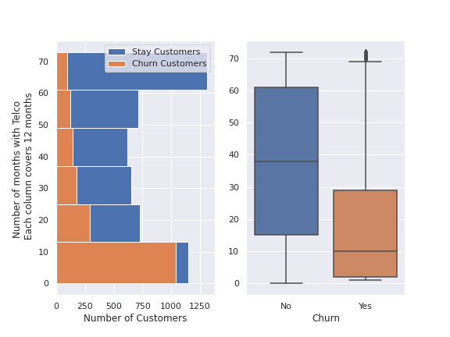
Initial Insights:
These charts are looking at the tenure of a customer and if they left Telco or stayed with Telco.
Notice: Over half of the Churn customers left in the first year!
Blue = Stay
Orange = Left
Y axis = Months with Telco
Notes:
The histogram chart clearly shows that there is a significant number of the churrn customers who leave within the first year of their service with Telco. This is a mjor issue tat need to be looked into. It is interesting to note that there seems to be two major groups of the customers who have stayed with Telco, almost and inverse normal distribution. By looking over at the box plot which shares the same Y-axis, the mean for stay customers is just over 3 years, but 25% of the customers are either first year customers or customers that have been with Telco for over 5 years (60 months).

Slide 10
Take Away:
Telco should look into why so many of their customers are leaving with in the first year.

Slide 11
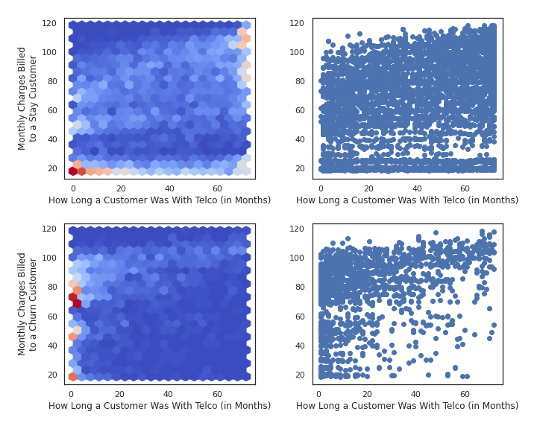
Initial Insights:
Red= More customers
Blue= None or few customers
Each dot= at least 1 customer
Monthly Charges (y-axis) vs
Tenure (x-axis)
Top two graphs = Stay Customers
Bottom two = Churn Customers
Notice: The stay are clustered in the bottom left and top right of their cluster graph.
The churn are clustered around the $70 -$80 price point on the left hand side of their cluster graph
Notes:
The major story comes from the two hex graphs which shows the density of how many customers fall into the area of that part of the graph. There are two different stories here. For the Churn customers (the bottom left graph), the customers who leave are predominantly located in the areas between the $70-$80 price point. There are also 2 other small clusters of customers located around the $45-$50 price point and the $20 price point.
For the stay customer hex graph (the top-left graph) there are clusters of customers at the $100+ price point, the $80-$95, and the sub $20 price point. There is also a small cluster of stay customers at the $50 price point. This appears to be a newer cluster of customers than the predominantly older tenured customers who are paying at the higher price points. The sub $20 price point customers are fairly evenly distributed across all months.
Considering the types of contracts that Telco offers: month-to-month, 1 year, or 2 year there might be an expectation to see a major increase of Churn customers at the 12-month and 24-month marks, but this is not evident in these graphs. There no clusters of Churn customers at those marks on the bottom left graph and there are no sudden decreases in the concentration of customers on the stay customer hex graph (top left) either.

Slide 12
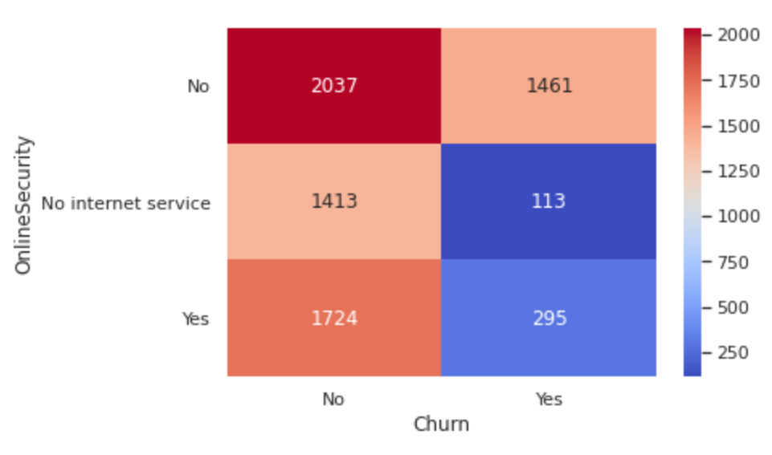
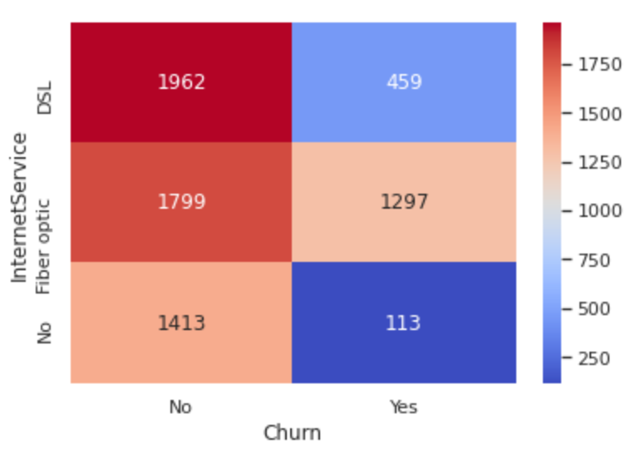
Initial Insights:
Top: Customers who bought Online security from Telco (representative of the 6 internet services based heat maps)
Bottom: Type of internet service customers purchased
Both: Left column = stay
Right column = churn
Notice: The high number of churn customers who had internet service but did not have online security.
The high number of churn who purchased fiber optic
Notes:
The two interrelated stories presented in these heat maps show that those who are purchasing fiber optic internet service are much more likely to churn than those who do not. And, it seems related to the last point is that the customers who purchase extra internet services are much more likely to stay with Telco than those who do not.
These two heat maps help explain the differences between the two hex graphs on the previous slide. The cluster of churn customers who are around the $70-$80 price point seems to be related to the customers who are purchasing fiber optic internet but are not purchasing any extra internet services.

Slide 13
Take Away:
Telco should look into how to either keep the $70-$80 price point customers (those who are just purchasing fiber optic) or up-sell them on internet services to the $90-110/month price point.

Slide 14
The Models

Slide 15
Quick Summary:
Primary metric for measuring models: Yes Recall Score ( the score of the model at being able to correctly identify customers who would end up leaving Telco)
15 models were tested
Used Logistic Regression and Random Forest Classifier models
Used an over sampling method (SMOTE) and an undersampling method (Nearmiss) to address data imbalance
Trained some models on feature selected data and on data from just first year customers.

Slide 16
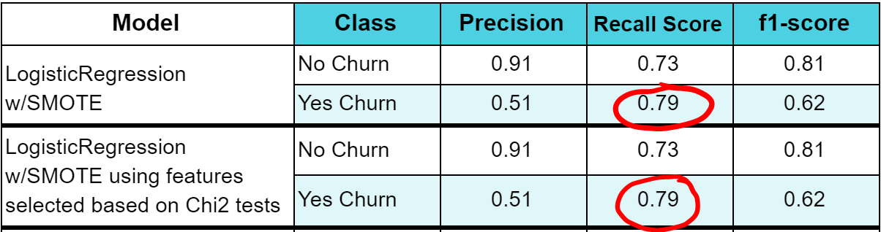
Top 2 Models:

Slide 17
With the given data,
79%
of Telco’s churn customers during a given month can be identified

Slide 18
Post Model Analysis:
Weighted to Churn:
Fiber Optic
No Phone Service
Paperless Billing
Weighted to Stay:
Two Year Contract
One Year Contract
Tech Support
Notes:
Using Coef_ for LogisticRegression models and feature_selection_ for the RandomForestClassifier models, these were some of the top weighted categories that the models used to predict the probability that a select customer would churn or stay with Telco. This confirms much of the analysis that was gleaned from the EDA.
In terms of what might be causing customers to leave Telco: signing up for fiber optic services, not purchasing any phone service, and having paperless billing all seemed to indicate a customer might churn.
In terms of what might be keeping customers with Telco, major features were customers who signed up for two year contracts, customers who signed up for one year contracts, and those who used the technical support services.

Slide 19
The Conclusions:

Slide 20
Use of the Model:
If just 50% of the customers identified by the best model ended up staying with Telco, they could retain up to almost
$55,000/month!
The diagnostics on the model could help further identify possible reasons for customer churn.

Slide 21
Further Business Research Needed:
Look into the reason customers are leaving within the first 12 months of being with Telco
Look into why so many Fiber Optic customers are leaving
Look into why the customers who purchase internet but do not buy any of the extra services are leaving as compared to the customers who are purchasing the extra internet services (also the price point for the extra services might be below other providers in the area, hence high customer loyalty).
Look into the month-to-month payment option as 43% of those customers ended up leaving.
Notes:
For the first point, this was addressed on slide #9.
For the second point, this was addressed on slides #12 & 18.
For the third point this was addressed on slides #11, 12, & 18.
For this last point, it was addressed on slides #11 & 18.

